Slide 1
Team 3 Final Presentation
CS691 – Spring Semester 2021

Slide 2
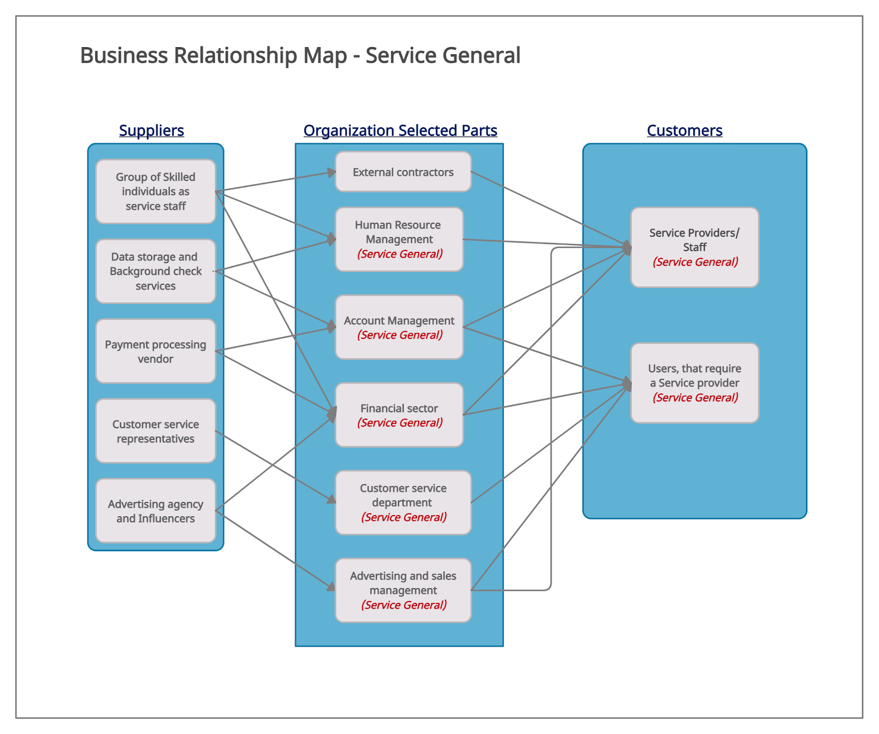
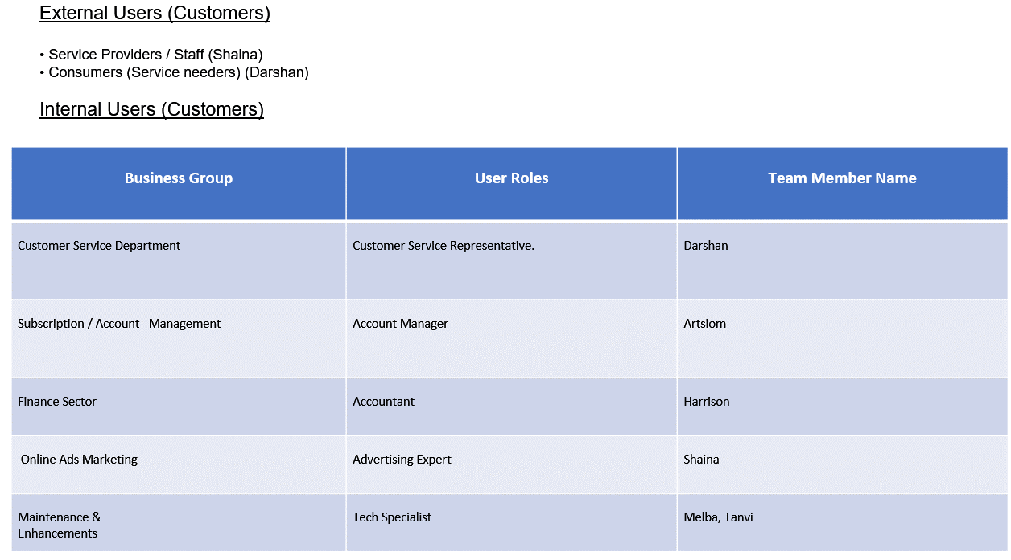
BRM Diagram and UserRoles - Darshan
https://drive.google.com/file/d/1-WaZ3k50DidlJzNX1pF9WMpHHWtY4DC7/view?usp=sharing

Slide 3
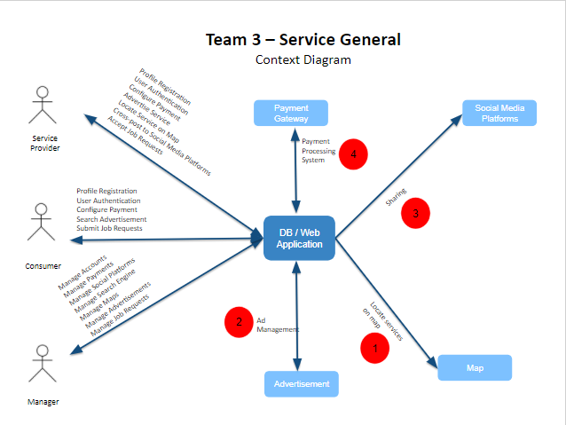
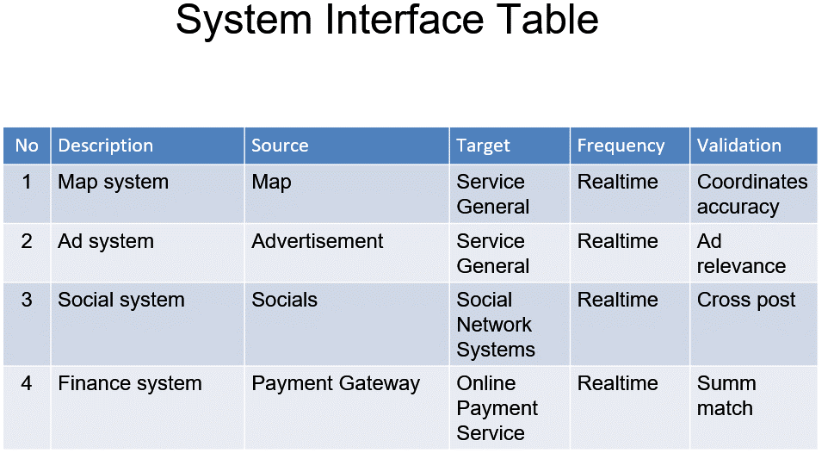
Context Diagram and System Interface - Darshan
https://drive.google.com/file/d/1amefj7oUf2dK86ygpE2O67hFDBJm31u-/view?usp=sharing

Slide 4
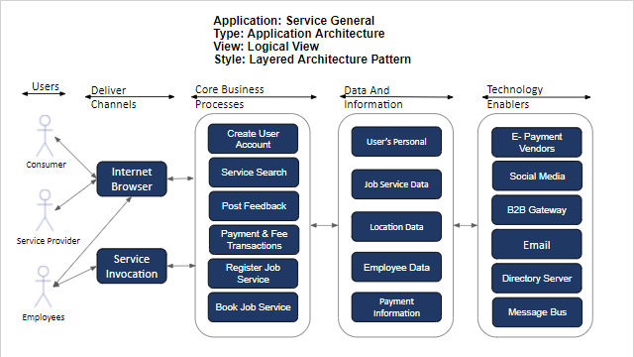
Architecture Design Logcial & Process - Harrison
https://docs.google.com/presentation/d/1eGooqE9T2ky9jCifPsUOF_FMpJ652KHYuPFWKS7dxWA/edit?usp=sharing

Slide 5
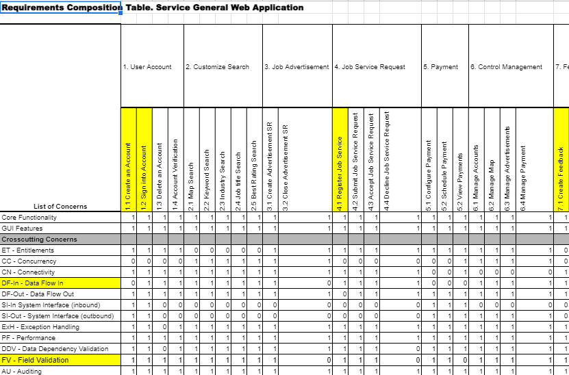
Requirements Composition Table - Tanvi
https://docs.google.com/spreadsheets/d/1S4nBpdGwogCRV9VIkMYGgJpkP5rgY1lGOK3QH5SXoL0/edit?usp=sharing

Slide 6
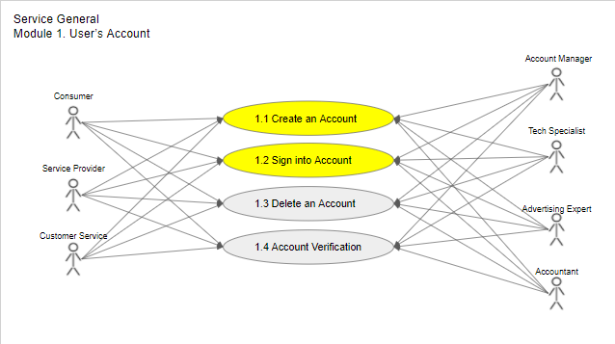
Use Case Diagram - Harrison
https://docs.google.com/presentation/d/1TZPFrWfRJuPxHHEotklJjmaHWQGOru1hU50lI9x0lQw/edit?usp=sharing

Slide 7
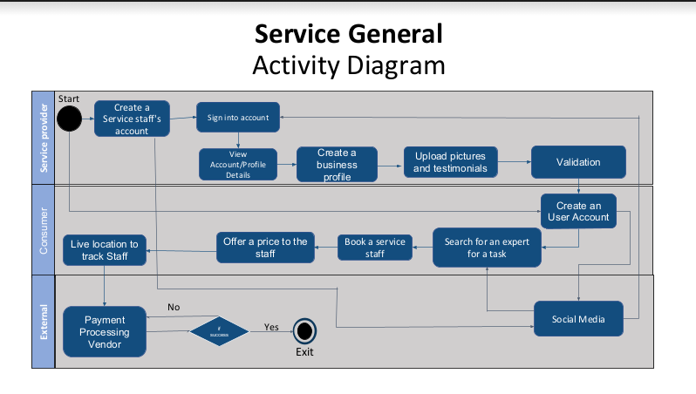
Activity Diagram - Shaina
https://drive.google.com/file/d/1EEaQ8F90HzzC6S8te5e74GAF6pw465_d/view?usp=sharing

Slide 8
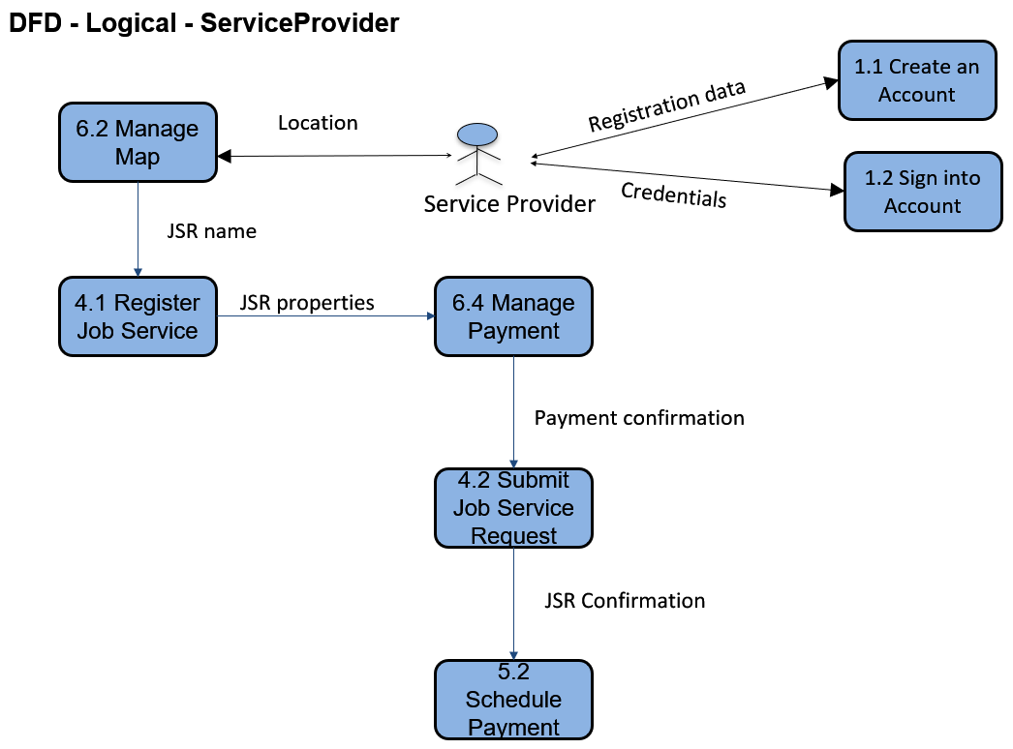
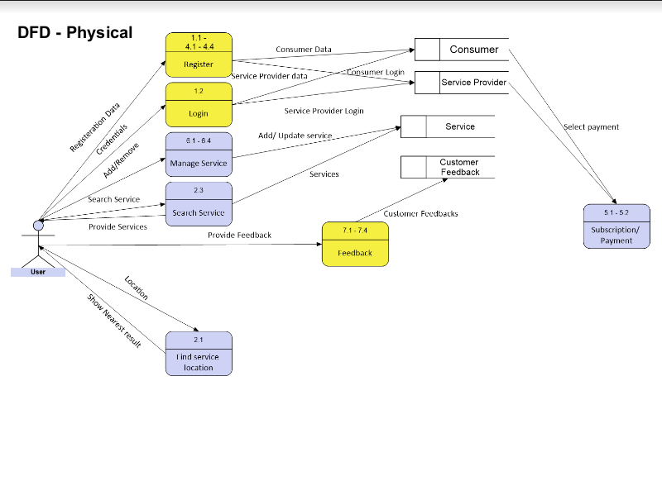
Data-Flow Diagram Logical, Physical - Artsiom
https://drive.google.com/file/d/14PmVpCJ4-0UPhbsUYnbA2KhctOLOFAXB/view?usp=sharing

Slide 9
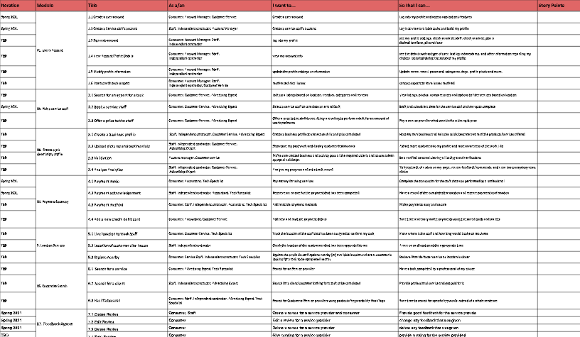
Functional Requirements/ User Stories - Shaina
https://drive.google.com/file/d/1Iw-uXDyK7wZHLt3s51CdDSwfv1Jso5Kg/view?usp=sharing

Slide 10
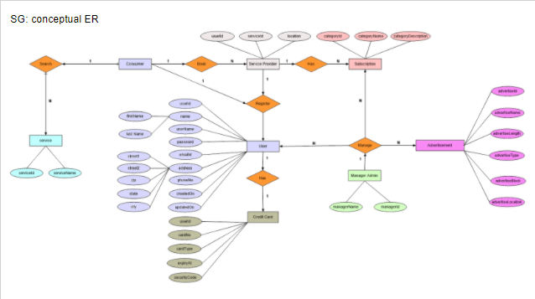
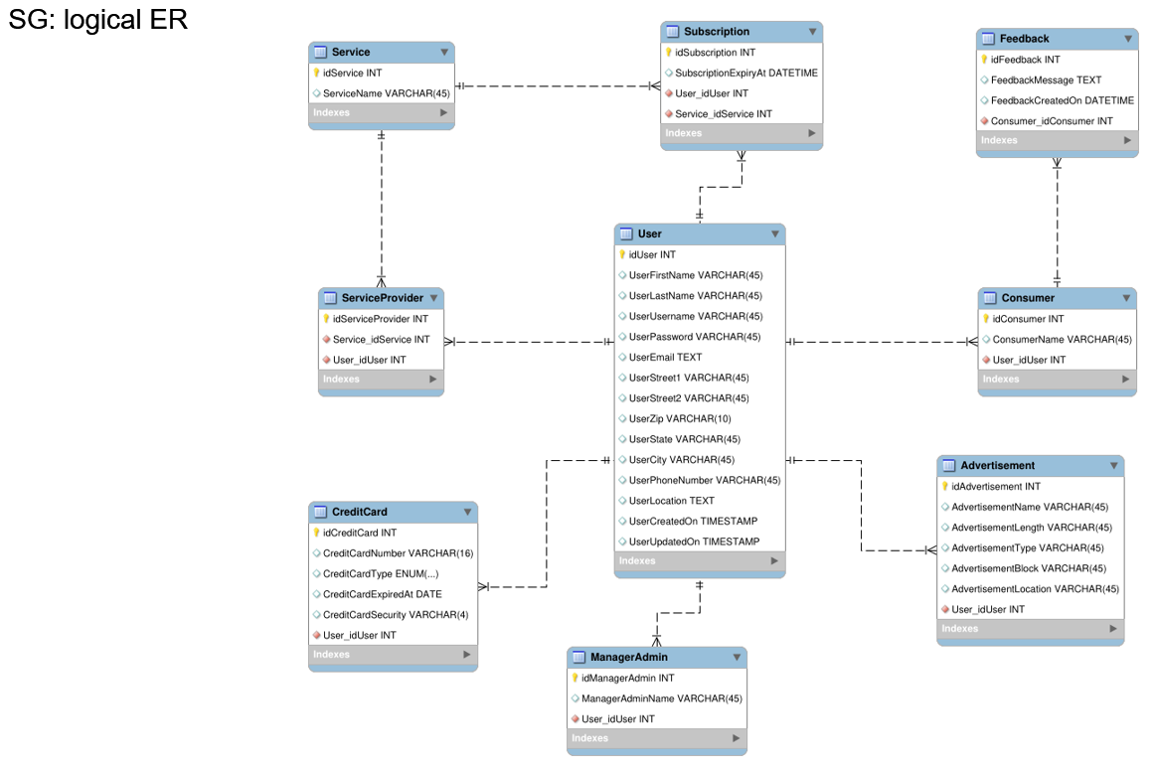
ER Diagrams (Conceptual, Logical) - Artsiom
https://docs.google.com/presentation/d/1HqAMSsvUAXLy7A195QKJW_UUE3zI58enD6QcSqLO6UA/edit?usp=sharing

Slide 11
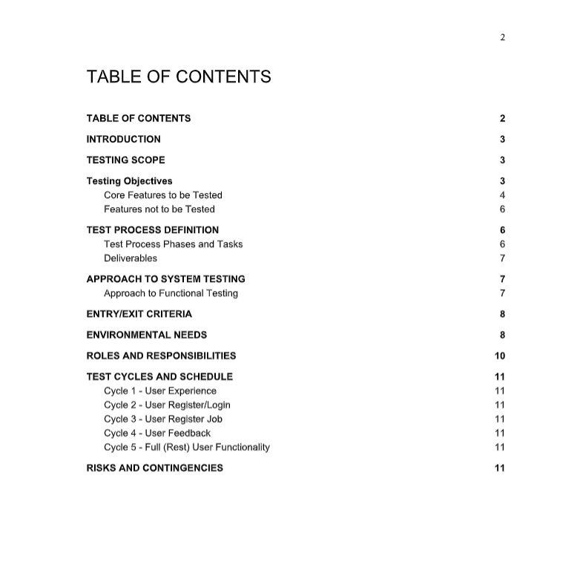
Test Plan - Shaina
https://drive.google.com/file/d/1RiZ8UUdo-jz22YPUs7Dnbwvv0rjY9aeh/view?usp=sharing

Slide 12
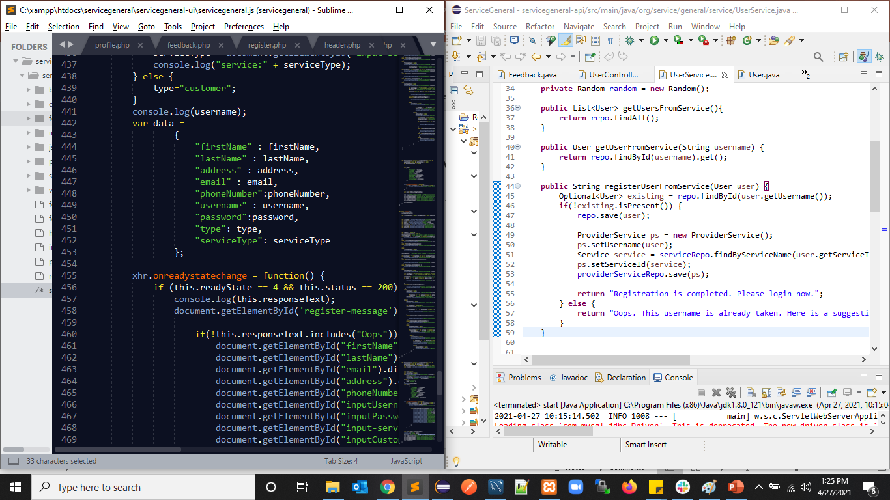
Source Code - Melba

Slide 13
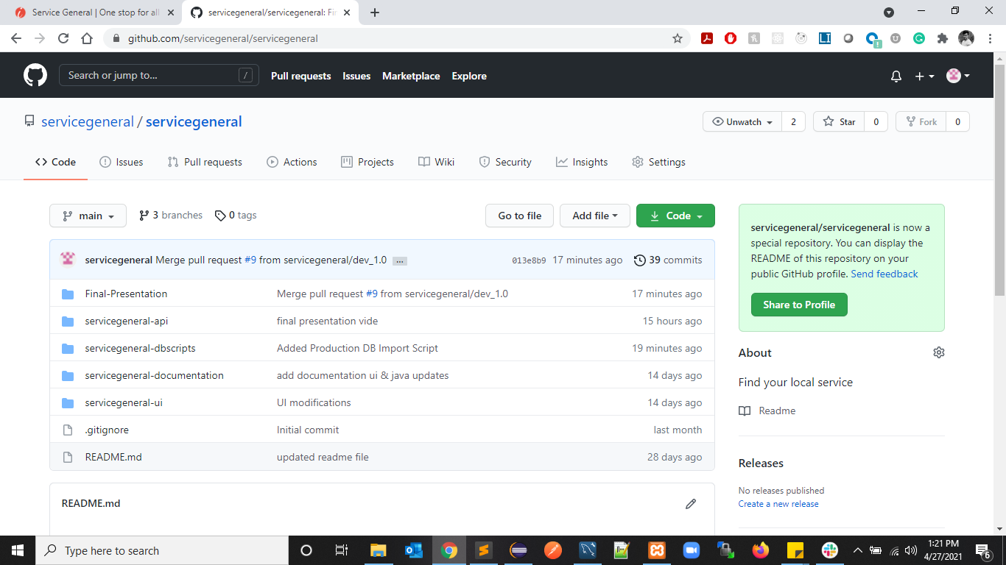
Github- Melba

Slide 14
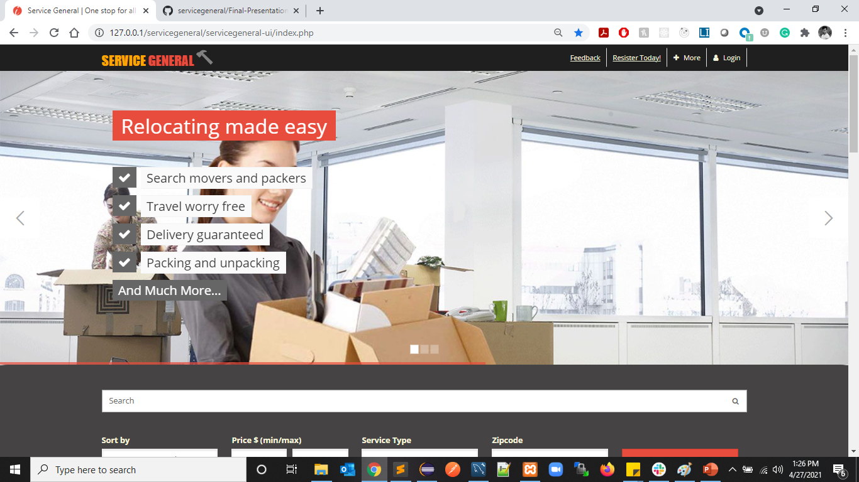
Demo - Melba

